Slide 1
Methods and goals
METHODS:
Sampling of 240 1year old shoots (120 from own-rooted plant; and 120 from grafted ones)
2020
Biometric measures at shoot level (diameter, length, number of nodes) of 1 year old shoots (parent);
Qualitative measures at node level (type of bud/sylleptic (M= mixed, C=catkin, V=vegetative, B=blind) of the same 1 year old shoots
2021
Biometric measures at shoot level (diameter, length, number of nodes) of 1 year old shoots (child) born from the parerent;
Qualitative measures at node level (type of bud/sylleptic (M= mixed, C=catkin, V=vegetative, B=blind) of the same child shoots
GOALS:
The model of my dreams should answer those questions:
How 1 yeard old shoot is composed?
There are some zones of the same type of bud?
There are difference in composition according to the length of the shoot?
How is the behavior of lateral shoots?
How many of them developed?
Where?
From which bud? (vegetative or mixed?)
how can we deal with multiple buds and multiple lateral shoots per node?
This problems cold be solved analysing the data:
From different point of views
Shoot scale
Metamer scale
Bud scale
With different tecniques:
exploratory analysis
Glms/marcovian
WE WILL FOCUS JUST ON ON OWN-ROOTED PLANTS

Slide 2
Hazelnut architecture

Slide 3
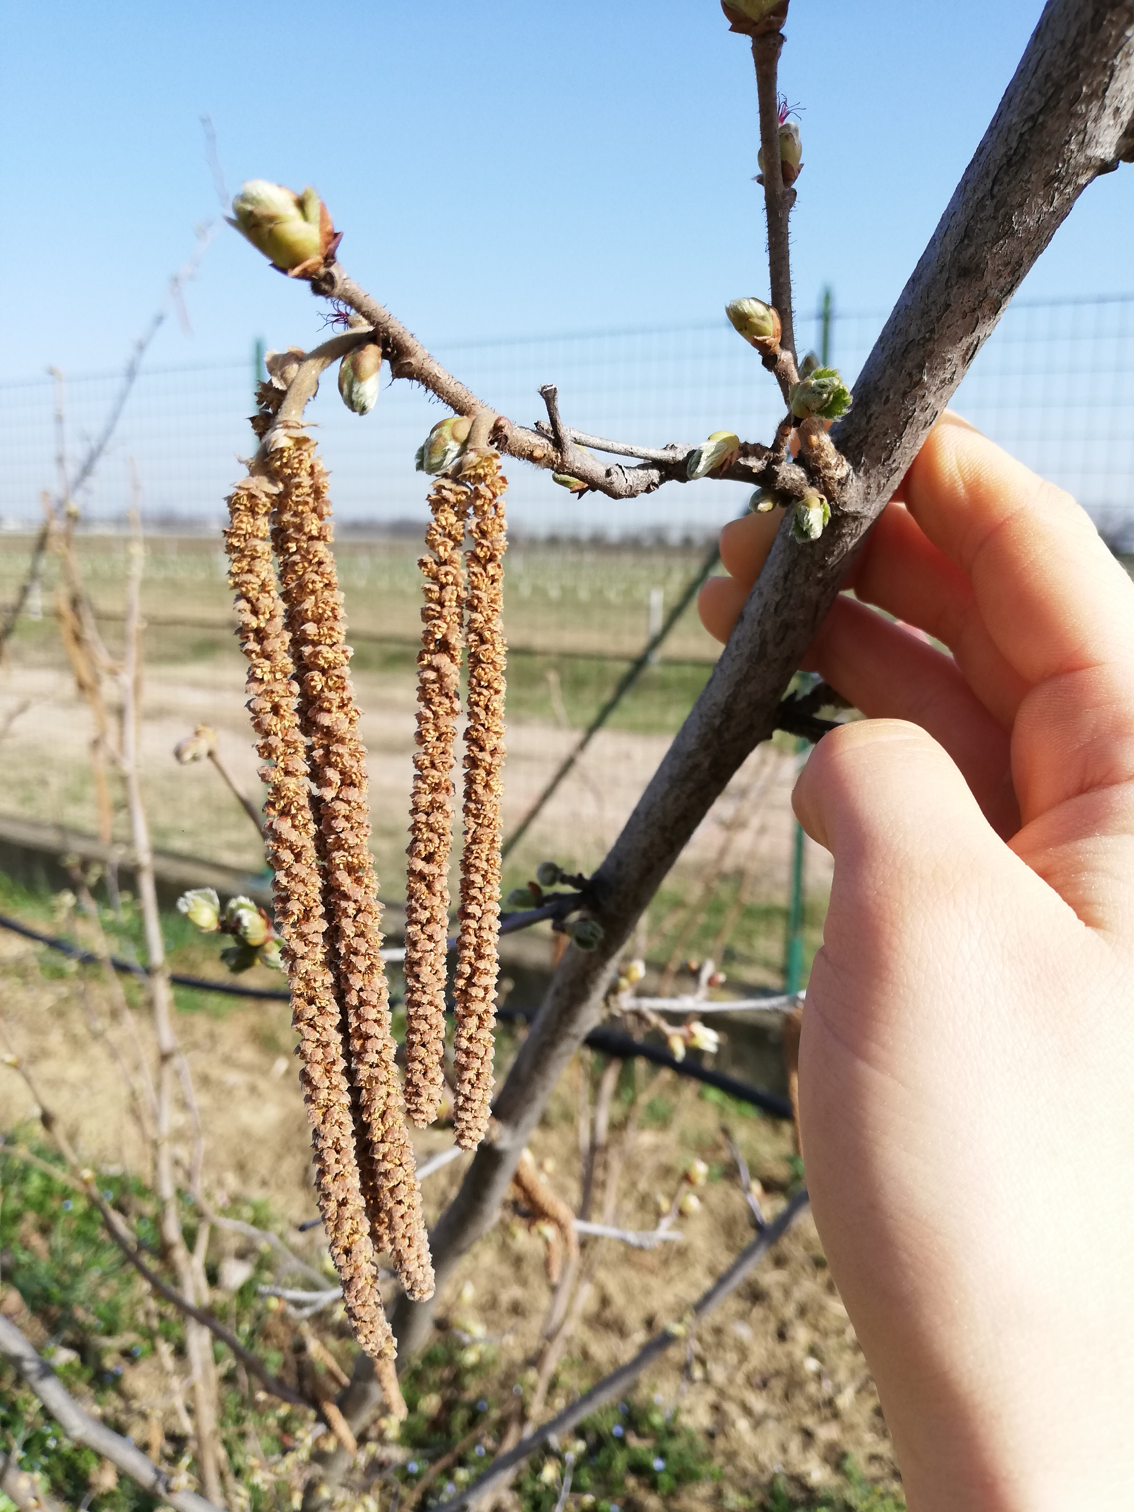
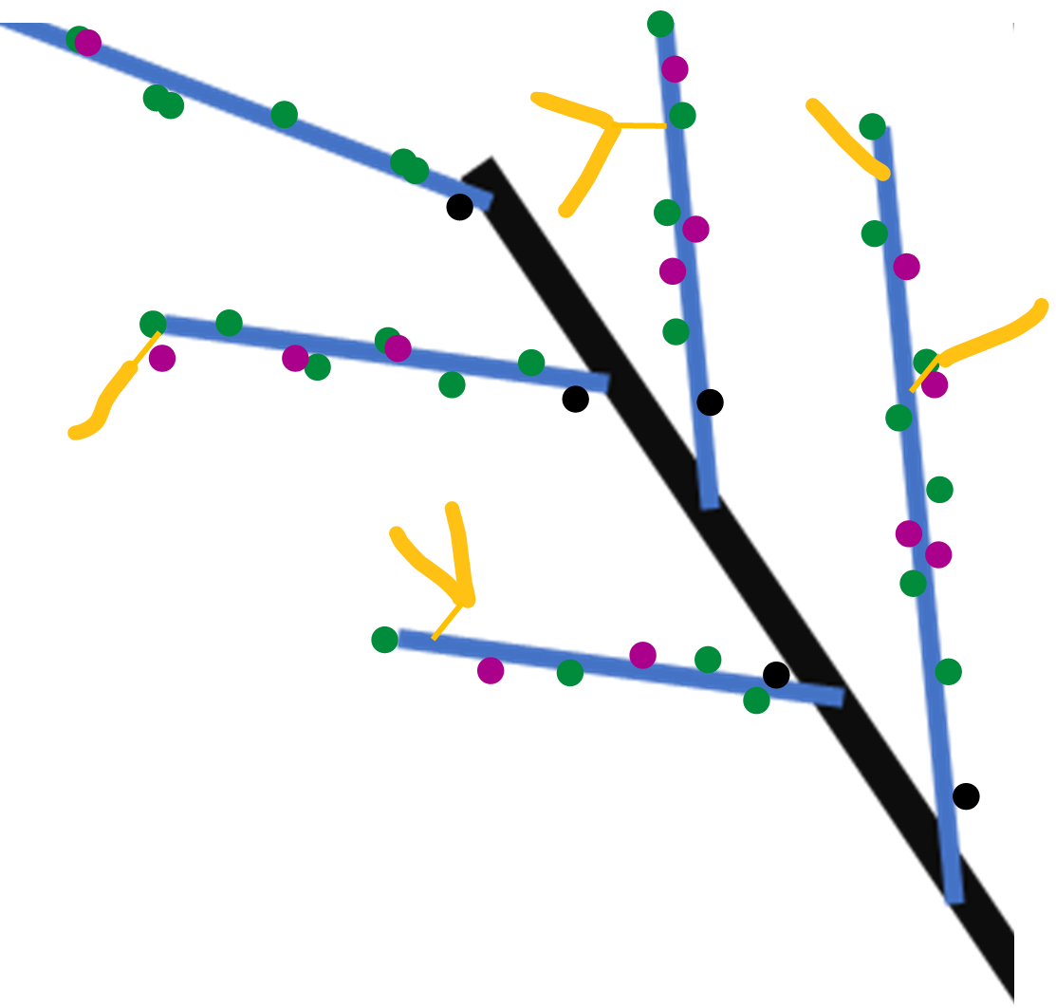
Winter observation
Year n
Year n
Proleptic shoot (referred to black)
Sylleptic shoot (referred to blue)
vegetative bud
Year n-1
Mixed bud
Blind node
catkin
SYLLEPTIC SHOOTS
Elongate while the parent is growing

Slide 4
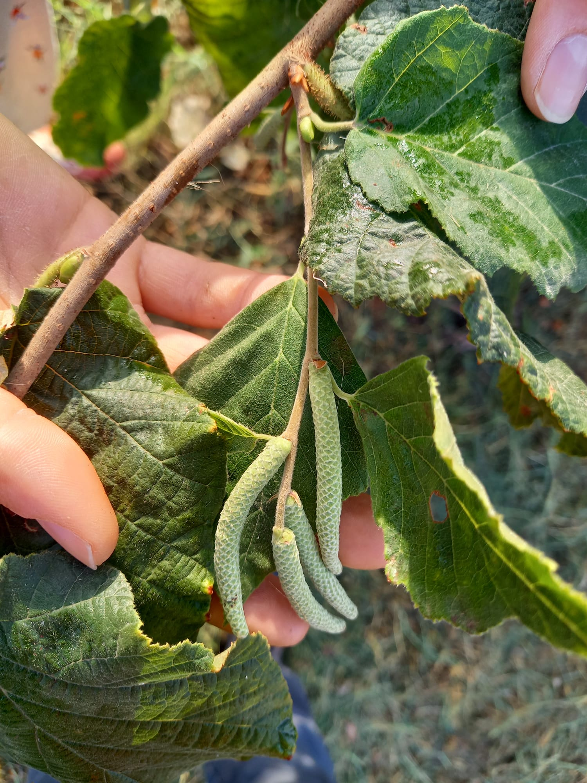
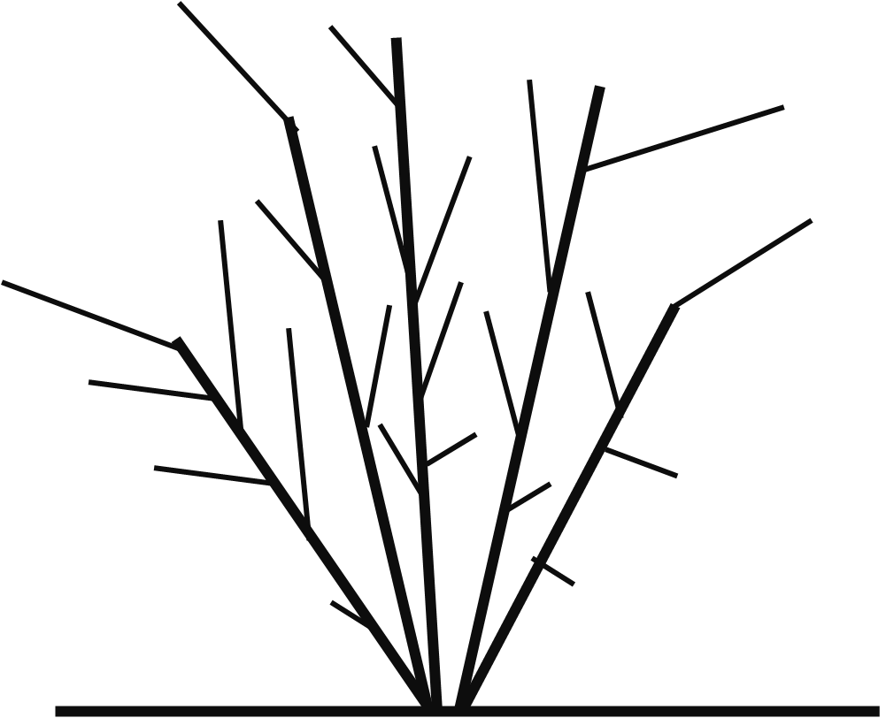
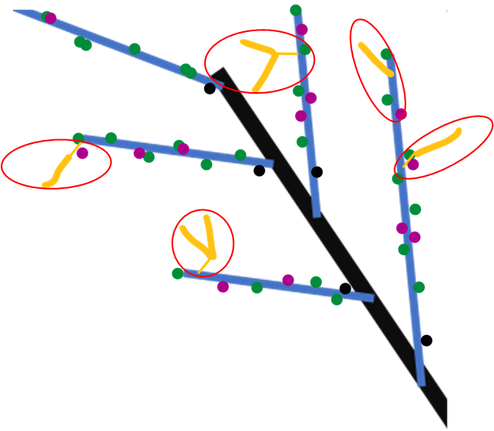

Spring growth
Year n+1
Year n+1
Year n
Year n-1
New proleptic shoot
Year n+1
New sylleptic shoot
Year n+1
leaves
SYLLEPTIC SHOOTS
(elongate now)

Slide 5
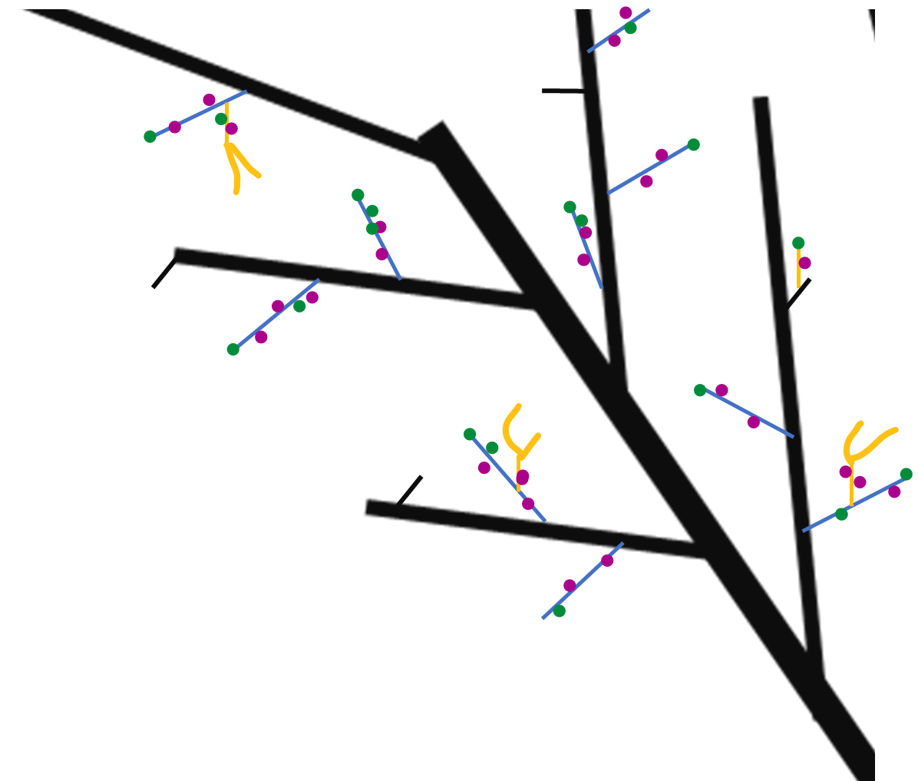
Next winter observations
Year n
Year n
Year n+1
Proleptic shoot
Year n+1
Sylleptic shoot
vegetative bud
Mixed bud
Year n-1
Blind node
catkin
SYLLEPTIC SHOOTS

Slide 6
GLMs
Markovian models
They are used to understand if a predictor describes a variable
Poisson if the variable is quantitative;
Binomial if the variable is categorical
Es. Is Vegetative bud burst (Y) depending on (~) length, rank node, sibling M, sibling V, tot buds at that rank?
They are used to understand if the variables (buds) can be grouped into homogeneus zones.
HAZELNUT ISSUES:
Dependencies between rank nodes;
Dependencies between buds at the same rank

Slide 7
DATASET_ARCHITECTURE HAZELNUT
Process
OWN-ROOTED e INNE
 | Starter DF | Ending DF | What was done | Scripts | Scale
1 | 2020DFAUTO.csv | 2020shoot_level.csv | Count number of buds per each shoot; Adding the plant ID to each shoot; | create_shootlevel.R | shoot
2 | 2020shoot_level.csv | 2020metamer_level.csv | Creating the dataframe at the metamer level | create_metamer_level.R | Metamer
3 | 2020metamer_level.csv | 2020metamer_level.csv | Information of how many shoots developed next year | modify_metlevel.R | Metamer
4 | 2020shoot_level.csv | 2020shoot_level_DEVELOPED.csv | CREATE A NEW DATASET WITH THE SHOOT OF 2020 THAT WERE FOUND IN 2021 | modify_shootlevel.R | Shoot
5 | 2020metamer_level.csv | 2020metamer_level_DEVELOPED.csv | CREATE A NEW DATASET WITH THE SHOOT OF 2020 THAT WERE FOUND IN 2021 | modify_metlevel.R | Metamer
6 | 2020metamer_level_DEVELOPED.csv | bud_level_develop.csv | Duplicate the rows for the number of buds of each metamer | create_bude_level | Bud
7 | bud_level_develop.csv | bud_level_FINAL.csv | Position of the bud (lateral/apical) Fate of each bud Number of sibling buds (in multiple buds Numberof new shoots Info regarding the new shoot developed Substrating to the sibling value the fate of that bud | create_budlevelFINAL.R | Bud

Slide 8
DATASET_ARCHITECTURE HAZELNUT
Process
OWN-ROOTED
 | Starter DF | Ending DF | What was done | Scripts | Scale
8 | bud_level_FINAL.csv | bud_level_LATERALS.csv | Filter just for lateral buds | modify_budscale.R | Buds
9 | bud_level_FINAL.csv | bud_level_APICALS.csv | Filter just for apical buds | modify_budscale.R | Buds
10 | 2020metamer_level_DEVELOPED.csv | met_level_develop_lateralbuds.csv | Modifying the count of buds per each node, removing the apical bud!!! | modify_metlevel.R | Metamer
11 | 2020shoot_level_DEVELOPED.csv | 2020shoot_level_DEVELOPED_fin.csv | Adding the info of how many lateral and apical buds and the fate of apicals | modify_shootlevel.R | Shoot
12 | 2020shoot_level_DEVELOPED_fin.csv | shoot_level_develop_lateralbuds.csv | Modifying the count of buds per each node, removing the apical bud!!! | modify_shootlevel.R | Shoot

Slide 9
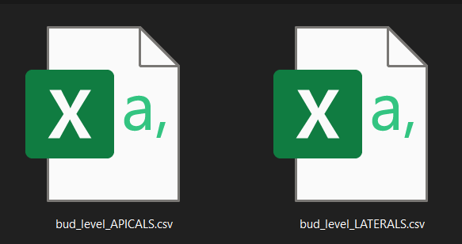
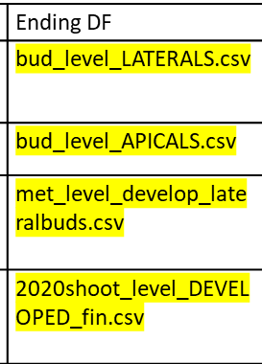


What will we use
Bud scale
Metamer scale
Shoot scale

Slide 10
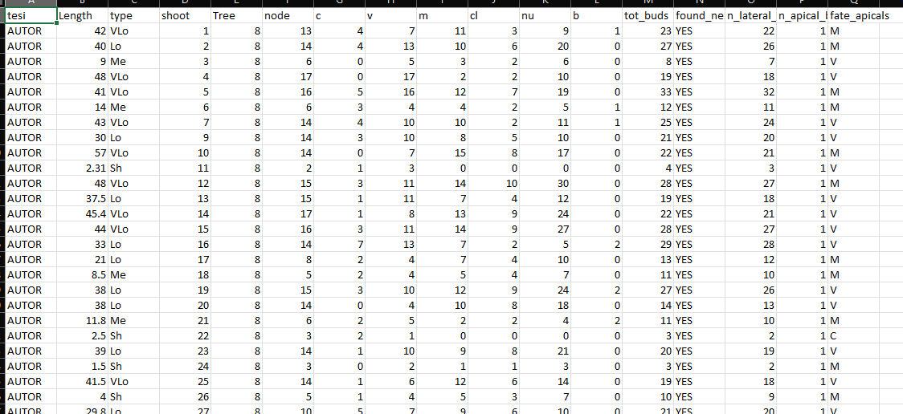
Shoot scale
Description of each shoot composition in terms of:
row ID
Not grafted
Plant ID mother of the shoot
Length(cm);
Length(class);
Number of nodes;
Number of buds per type (C,V,M,B);
Number of clusters;
Number of nuts;

Slide 11
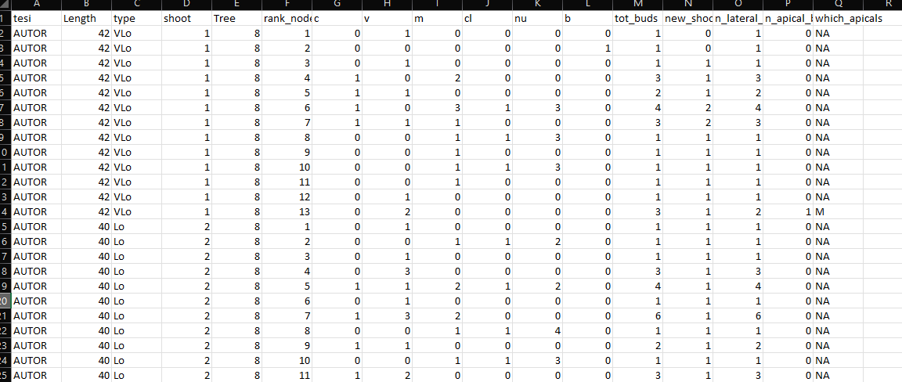
Metamer scale
Description of each metamer composition in terms of:
Year of sampling
Not grafted
Shoot length(class);
Shoot ID
Shoot length(cm);
Metamer ID
Number of LATERAL buds per eac rank (C,V,M,B);
Total buds per rank;
Shoots developed at that rank;
NUMBER LATERAL BUDS
NUMBER APICAL BUDS
FATE OF APICAL BUDS

Slide 12
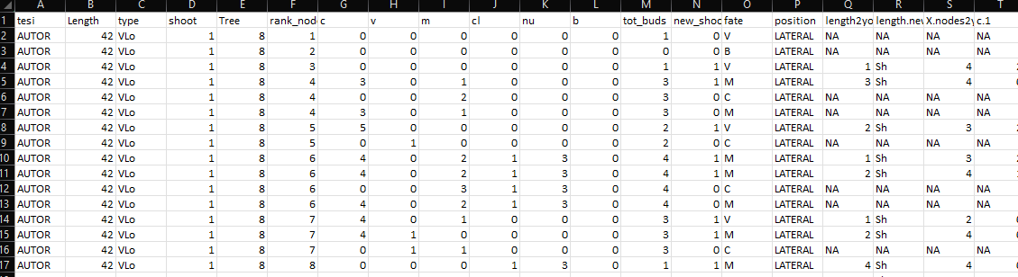
Bud scale
Description of each bud composition in terms of:
New shoot ID
Year of parent sampling
Shoot ID
Shoot length(cm);
Metamer ID
Number of sibling buds at the same node(C,V,M,B);
Total buds per node;
Number of Shoots developed at that rank;
Fate of bud (one per each row)
Position of the bud (apical/lateral)
Length of new shoot(cm)
Length of new shoot(class)
Information regarding each new shoot composition

Slide 13
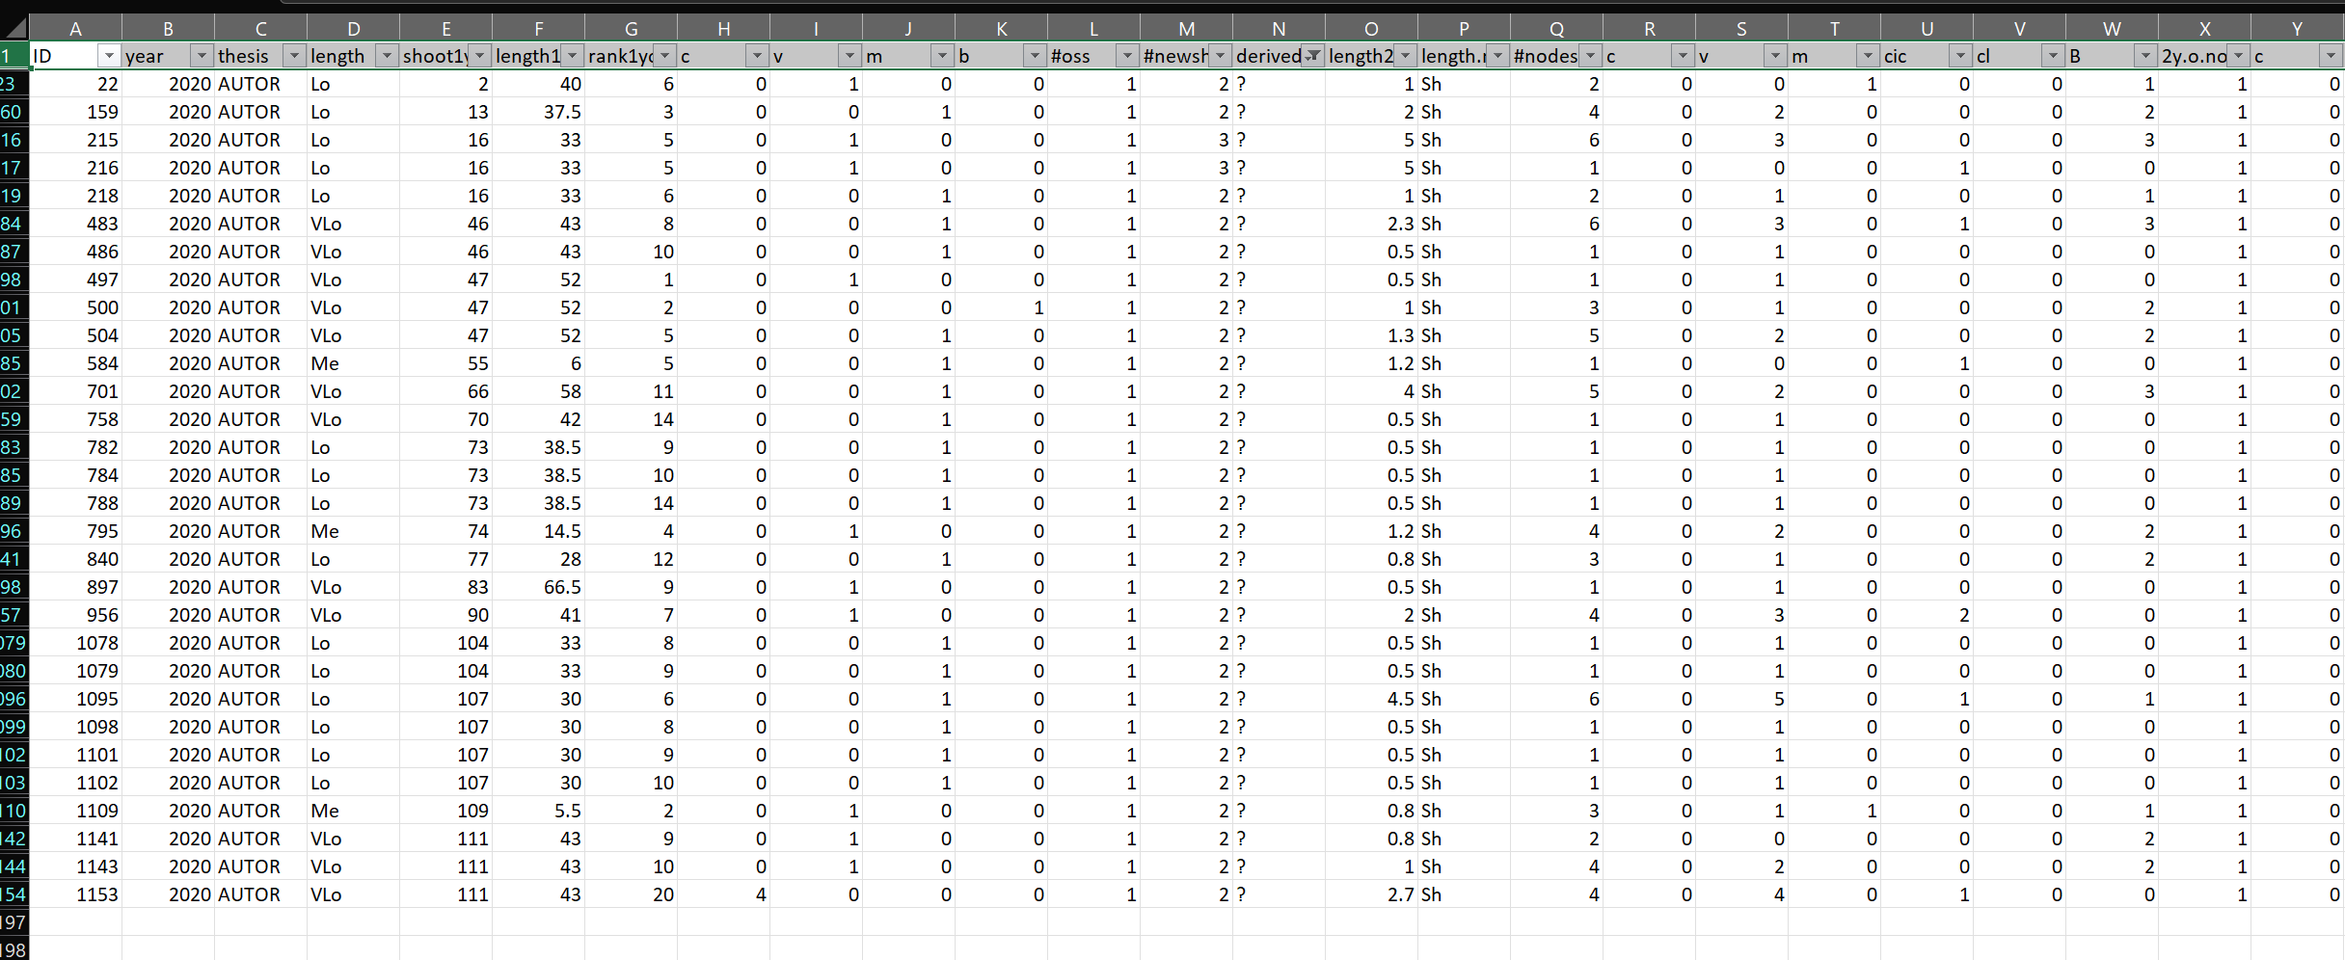
The original «new_shoots» file has the same information of the bud fate scale(in terms of new shoots details) plus it contains some the errors.
Errors= new shoots that i can’t explain from where they came from. Assigned as «?»
These errors impact less than 3% on the totals, so i guess we can ignore them and use the bud_scale file also for new shoots. What do you thing?

Slide 14
GLMs example
glm(Y~F1+F2+F3+F4+F5+F6+F7, family=«binomial»)
PREDICTORS
Two GLMs:
For fate=V
For fate=M
F1
F2
F3
F4
F5
F6
F7
Y
How to Interpret glm Output in R (With Example) - Statology

Slide 15
Problems & solutions
Several predictors mask their effects (ES. NA values)
Run different GLMs avoid each time a predictor:
Y~tot_buds+length+rank
Y~M+V+C+length+rank
p. Value are significant because we have many data. Is real significance?
Permutation models + difference in AIC

Slide 16
Permutation models
GLMS(Y~A+B+C, data=DF)
Shows that A is really significant (***)
Permutation
We shuffle the variable A: DF$A=sample(DF$A)
We run again the glms GLMS(Y~A+B+C, data=DF)
If the significance was true, now A should be not significant any more
AIC difference
GLMS(Y~A+B+C, data=DF)
Shows that AIC is 800
AIC difference
We run a null model GLMS(Y~1, data=DF)
We make the difference between AIC real (800) and AIC null
Now we make permutation of a variable and we run again the model.
AICpermutation-AICnull should be GREATER than AICreal-AICnull!!!
Null models are made as follows:
Y~1+(significant predictor not shuffled).
Example in next slide

Slide 17
Make GLMs
Find dipendent variable (Y) and predictor (A). NB_start with 1 predictor and if it is significant, add the others.
Run the model glm(Y~A)
Is A significant?
No. → Stop. Try another predictor (B);
Yes. →
do 100 permutation (A=sample(A), for 100 times);
Find aic null model (Y~1);
Make aic null – aic permutation (Y~sample(A)) for 100 times;
Count how many (out of 100)of them are greater than aic null – aic real (Y~A)
Find another predictor (B);
Run the glm (Y~A+B)
Is B significant?
No. → stop. Try with another predictor (C);
Yes→do 100 permutation (B=sample(B), for 100 times);
Find aic null model (Y~A+1);
Make aic null – aic permutation (Y~sample(B)) for 100 times;
Count how many (out of 100)of them are greater than aic null – aic real (Y~A+B)
Continue like this with all predictors

Slide 18

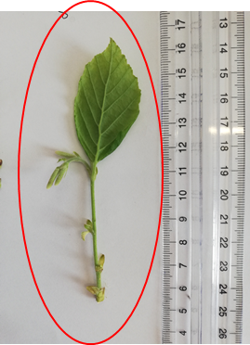
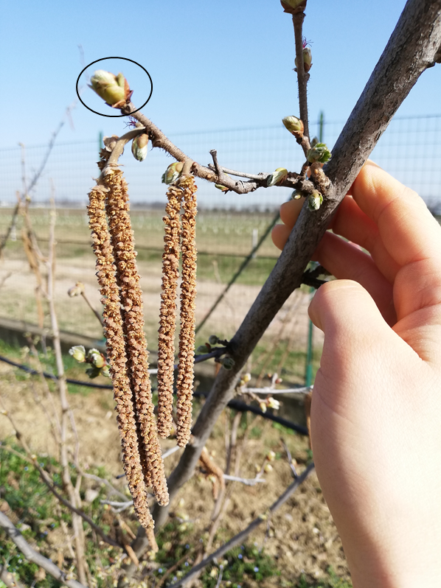
First approach to modelling
Box0:
How many nodes in that shoot
Box1:
Does that rank bear a sylleptic?
NO
YES
Box1.0: Existence of B (0,1)?
Box2: how many buds?
Box2: how many V and M buds?
Box3: proportion of V?
Box3: proportion of V ?
Box4: do you burst?
Box:3.1Proportion of M?
Box4: do you burst?
Box:3.1Proportion of M?
Box5: How many nodes OF NEW SHOOTS?
Box5: How many nodes OF NEW SHOOTS?

Slide 19
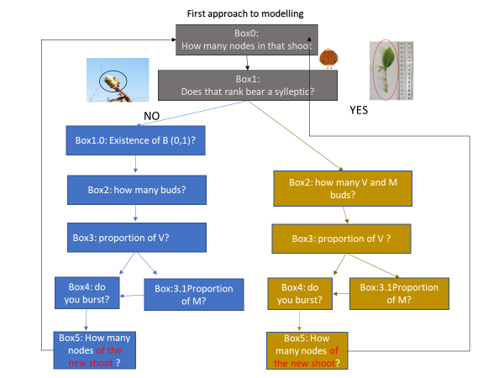
Box0:
How many nodes in that shoot

Slide 20
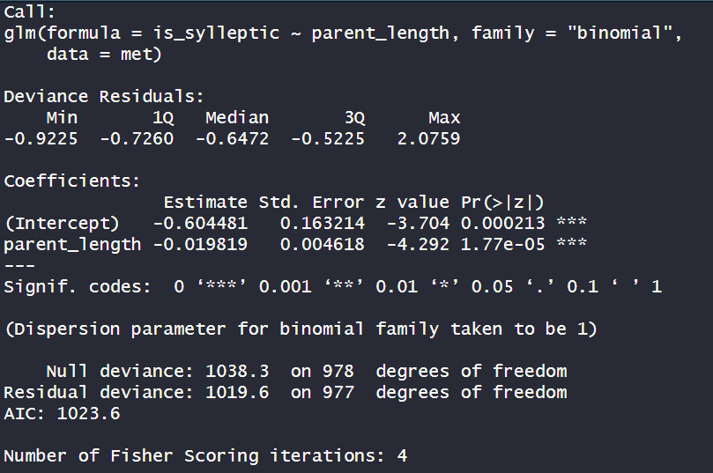
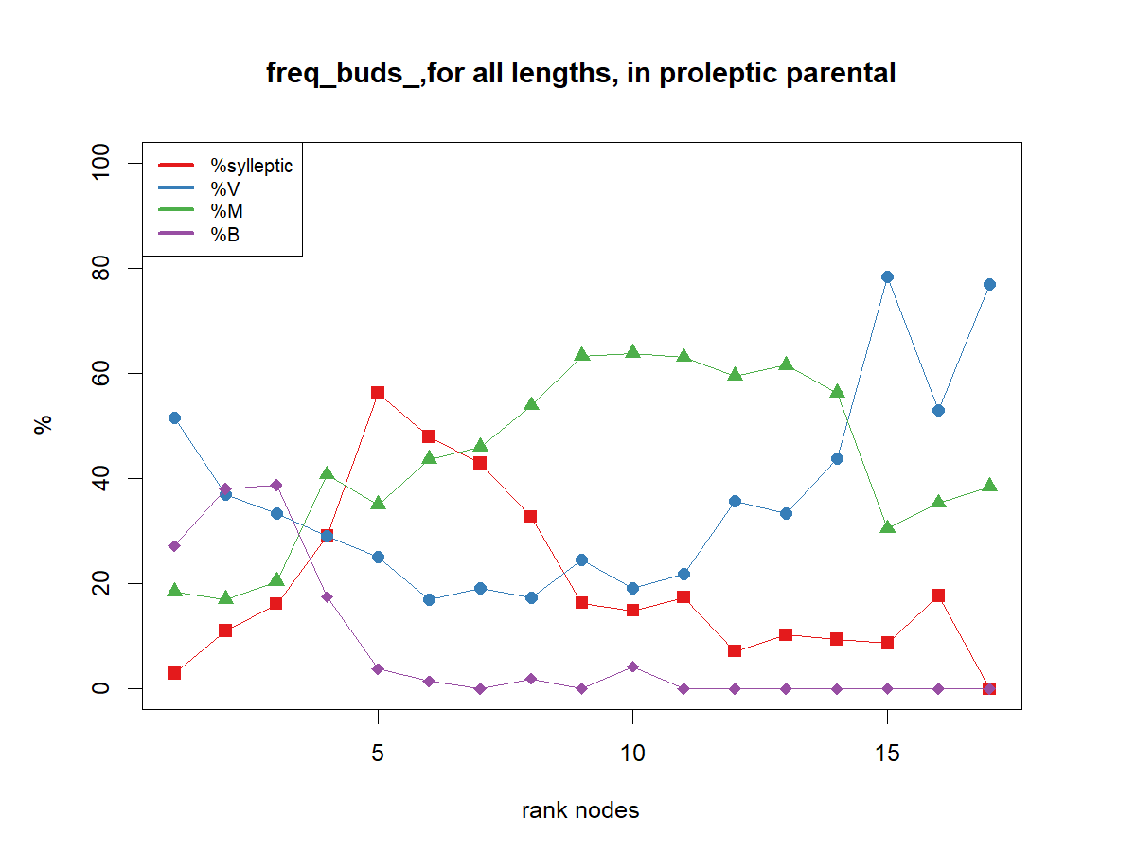
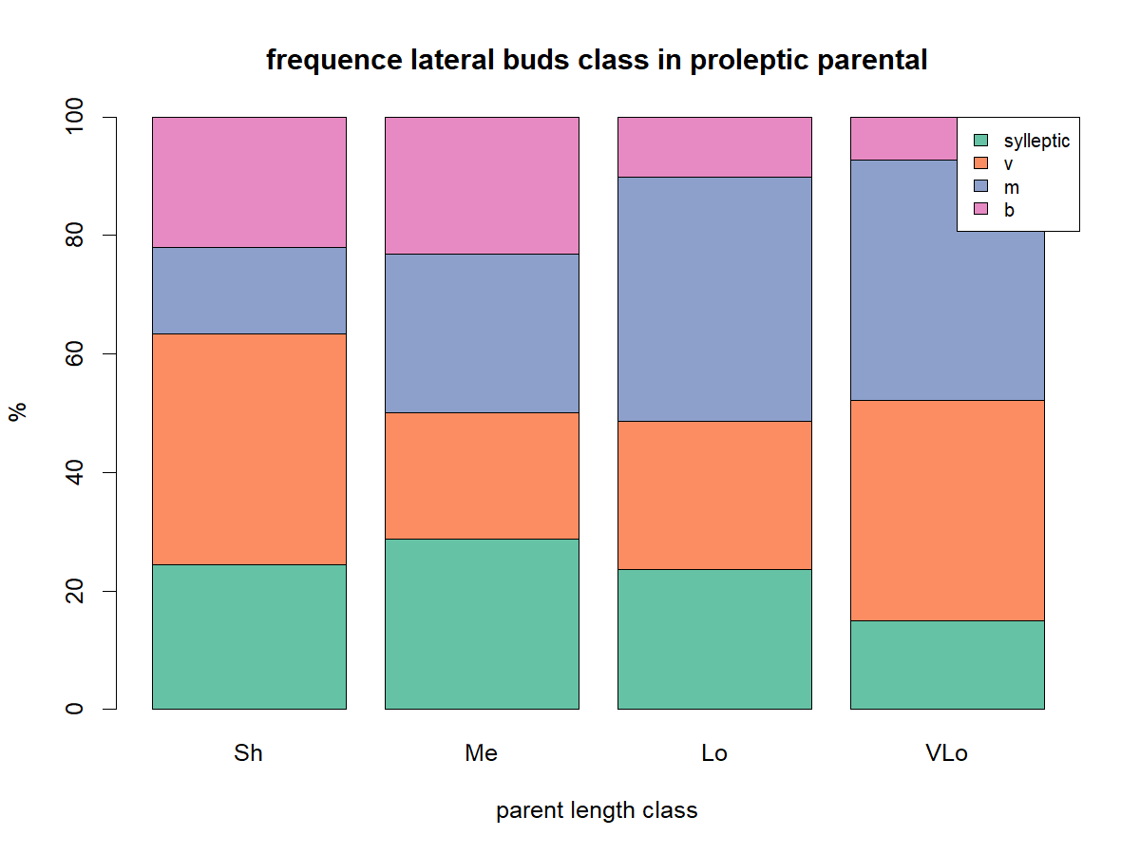
Box1:
Does that rank bear a sylleptic?
1_Relation with LENGTH of the parent (proleptic) shoot
Glm that relate if the bud is IN SYLLEPTIC shoot (1= YES, 0=NO) with length of the parent
Conc:
Length is significative (***). Coef -0.01
This could confirm what we saw in exploratory: more sylleptic in short and medium than in long and very long shoots

Slide 21
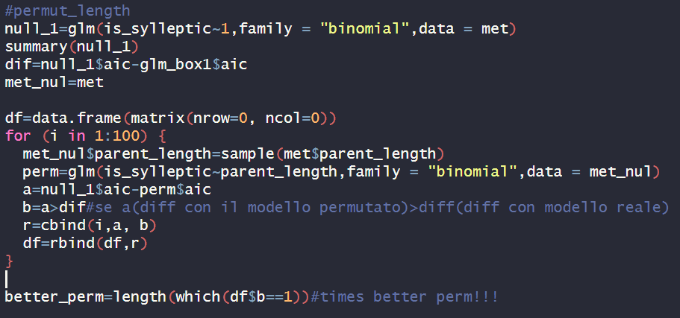
Box1:
Does that rank bear a sylleptic?
Permutation_length
0 times out of 100 the aic of null model- aic of permutated ones was greater than the difference with real model

Slide 22
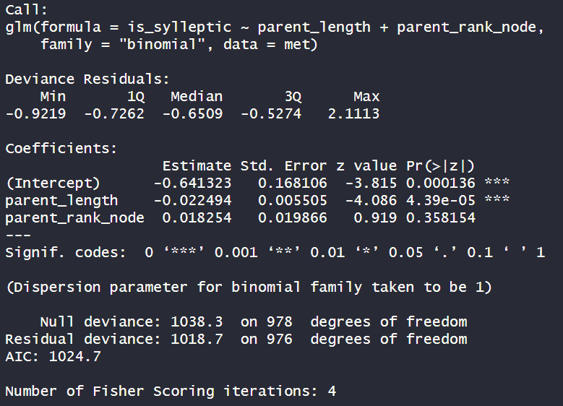
Box1:
Does that rank bear a sylleptic?
2_Relation with RANK
Glm that relate if the bud is IN SYLLEPTIC shoot (1= YES, 0=NO) with length
Conc:
RANK is NOT SIG
Because sylleptic are distributed in a median zone along the parent shoot, the rank does not have a linear effect:
we compute for each bud the distance to the shoot extremities, with reference 0 at the middle rank of each shoot

Slide 23
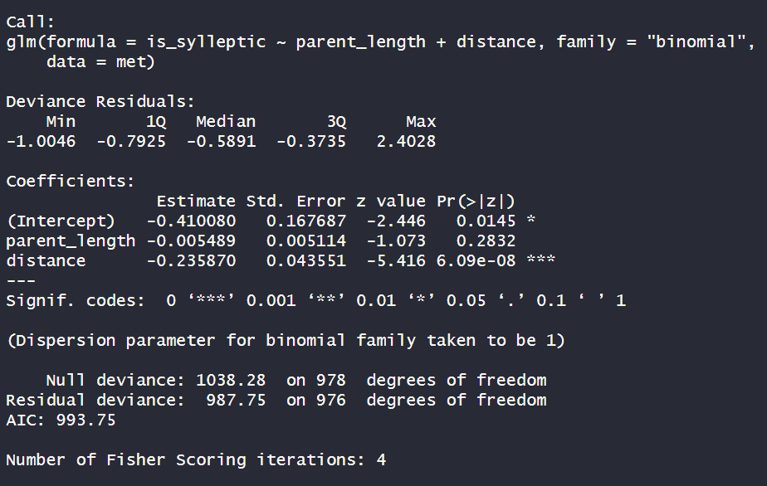
Box1:
Does that rank bear a sylleptic?
2_Relation with shoot length + DISTANCE
Glm that relate if the bud is IN SYLLEPTIC shoot (1= YES, 0=NO) with length
Conc:
Distance to the shoot extremities (with reference 0 at the middle rank) is significative (***). Coef?-0.23
Why length is not significant anymore? Because they are linked?
What should i do for permutation?

Slide 24
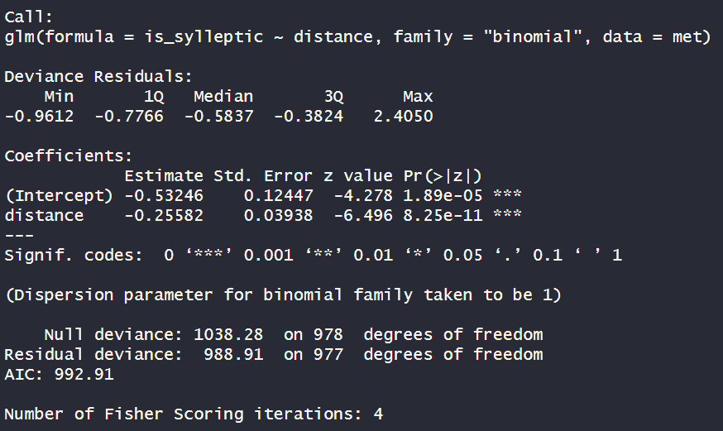
Box1:
Does that rank bear a sylleptic?
2_Relation with DISTANCE
Glm that relate if the bud is IN SYLLEPTIC shoot (1= YES, 0=NO) with distance
Conc:
Absolute value of distance of each rank from the mean rank of that shoot is significative (***). Coef?-0.25

Slide 25
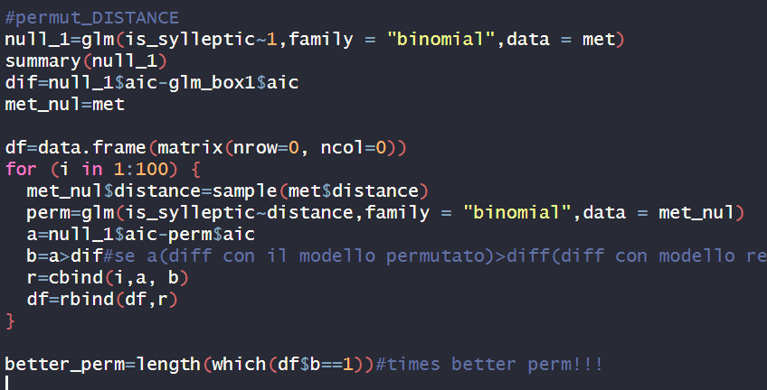
Box1:
Does that rank bear a sylleptic?
Permutation_DISTANCE
0 times out of 100 the aic of null model- aic of permutated ones was greater than the difference with real model

Slide 26
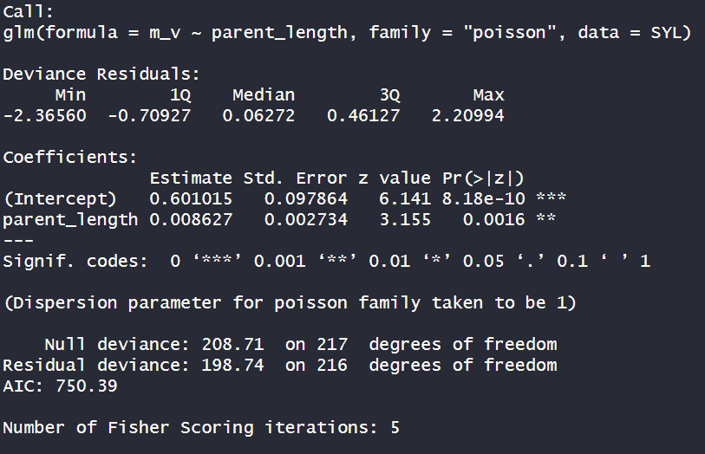
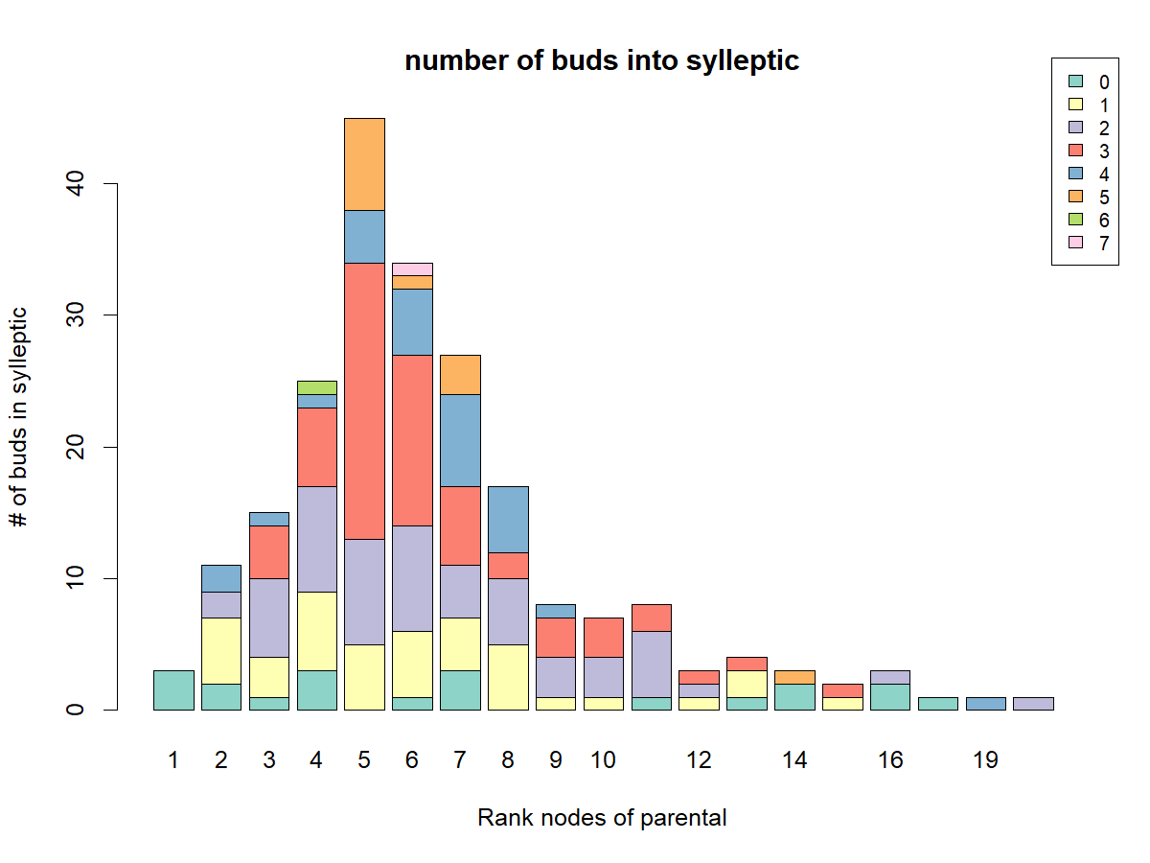
Box2: how many V and M buds?
1_Relation with parent shoot LENGTH
Glm that relates number of buds in IN SYLLEPTIC shoot with length of parent shoot
Conc:
Length is significative (**). Coef +0.008
This could confirm what we saw in exploratory: maximum variability in the number of buds of the sylleptic shoots borne on medium

Slide 27
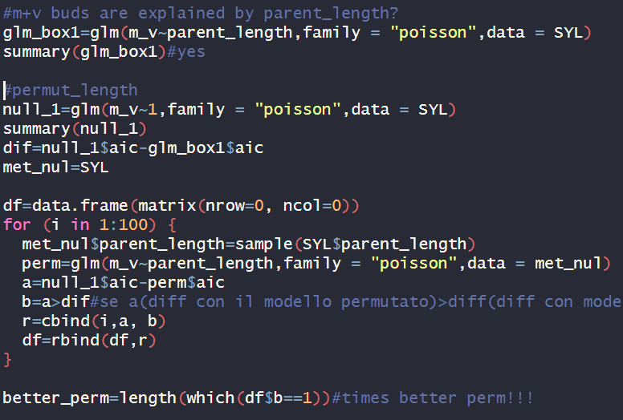
Box2: how many V and M buds?
Permutation_length
0 times out of 100 the aic of null model- aic of permutated ones was greater than the difference with real model

Slide 28
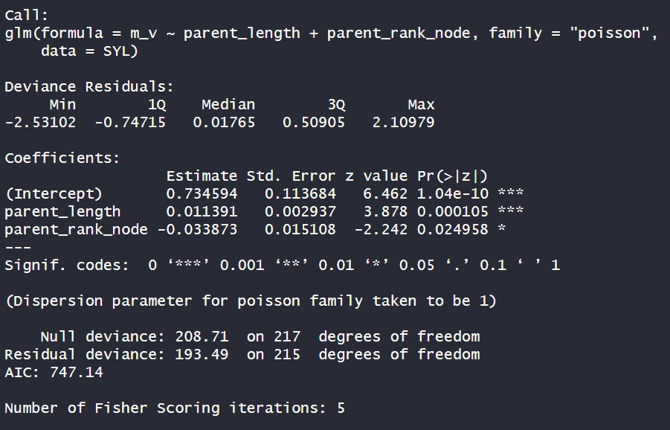
Box2: how many V and M buds?
2_Relation with LENGTH+RANK
Glm that relates number of buds in IN SYLLEPTIC shoot with length and RANK of parent shoots
Conc:
Length is significative (***). Coef +0.01
Rank is significative (*). Coef=-0.03

Slide 29
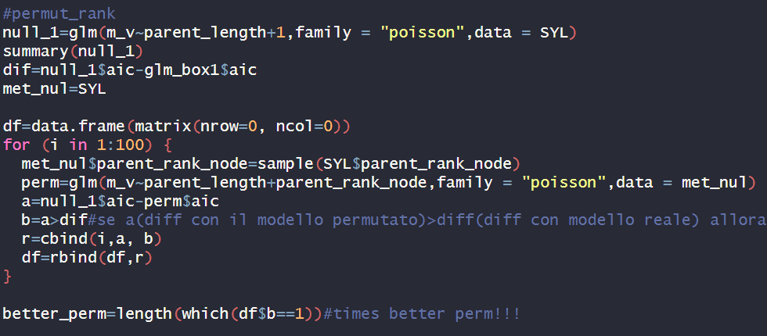
Box2: how many V and M buds?
Permutation_rank
0 times out of 100 the aic of null model- aic of permutated ones was greater than the difference with real model

Slide 30
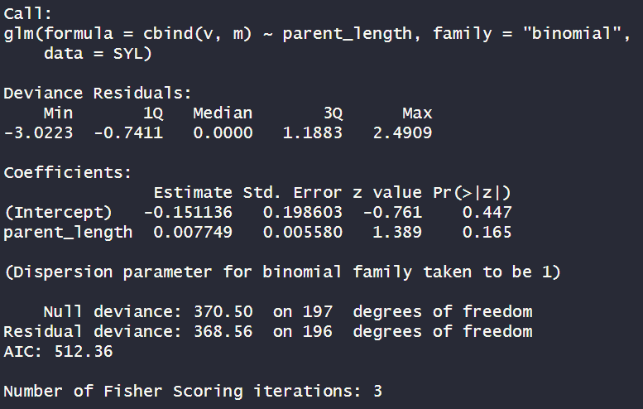
Box3: proportion of V ?
1_Relation with LENGTH
Glm that relate proportion ov V in IN SYLLEPTIC shoot with length of parental
Conc:
Length is not significative
ADD IMMAGE

Slide 31
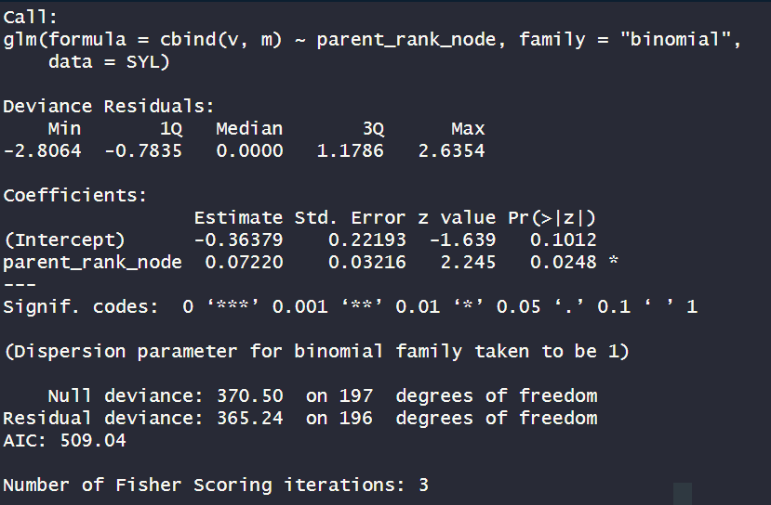
Box3: proportion of V ?
2_Relation with Rank
Glm that relates proportion of V IN SYLLEPTIC shoot with rank node along the parent shoot
Conc:
rank is significative(*). Coef. 0.07
ADD IMMAGE

Slide 32
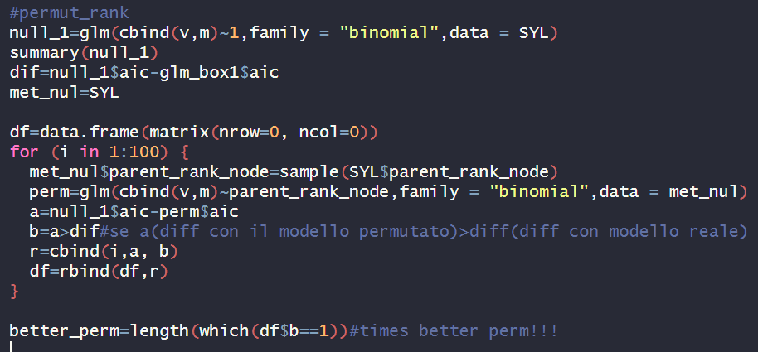
Box2: how many V and M buds?
Permutation_rank
10 times out of 100 the aic of null model- aic of permutated ones was greater than the difference with real model

Slide 33
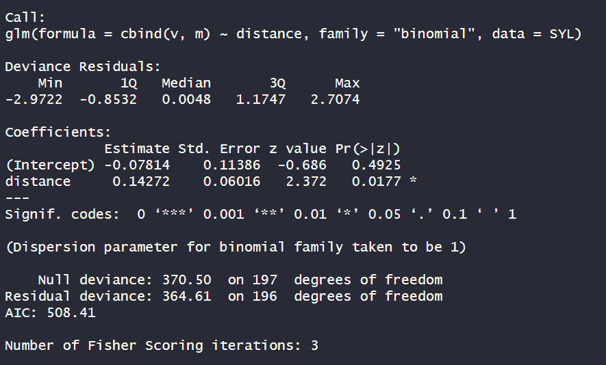
Box3: proportion of V ?
3_Relation with distance
Glm that relates proportion of V IN SYLLEPTIC shoot with distance
Conc:
distance is significative(*). Coef. 0.0.147
ADD IMMAGE

Slide 34
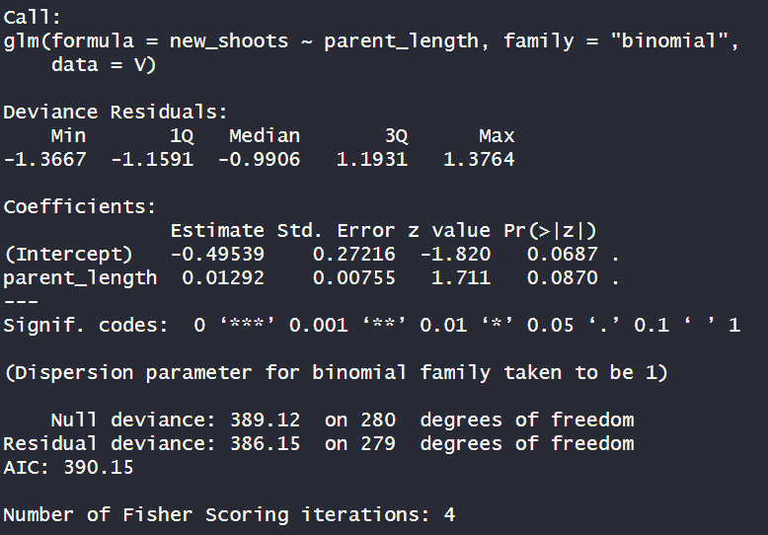
From V
Box4: do you burst?
1_Relation with parent LENGTH
New shoots (1=present, 0=absent), from V buds, related to parent length in sylleptic shoots
Conc:
Length IS NOT SIGNIFICATIVE

Slide 35
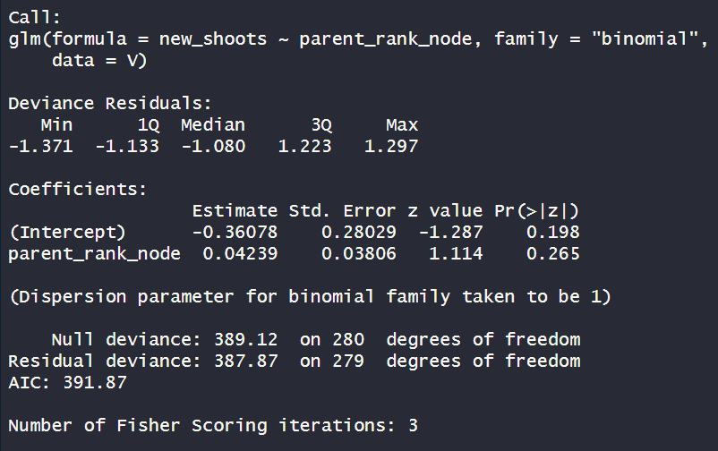
From V
Box4: do you burst?
2_Relation with parent RANK
New shoots (1=present, 0=absent), from V buds related to parentr ank in sylleptic shoots
Conc:
RANK IS NOT SIGNIFICATIVE

Slide 36
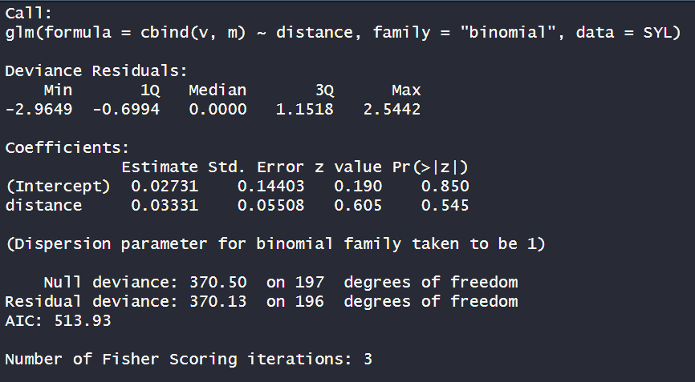
From V
Box4: do you burst?
3_Relation with distance
New shoots (1=present, 0=absent), from V buds, related to distance between parent ranks in sylleptic shoots
Conc:
distance IS NOT SIGNIFICATIVE

Slide 37
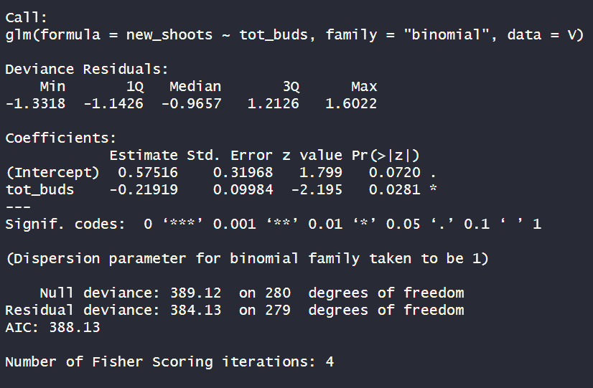
From V
4_Relation with TOT BUDS in that sylleptic
Box4: do you burst?
New shoots (1=present, 0=absent), in V buds, related total buds (v+m) of the sylleptic shoot
Conc:
Tot buds is significative (*). Coef=-0.21

Slide 38
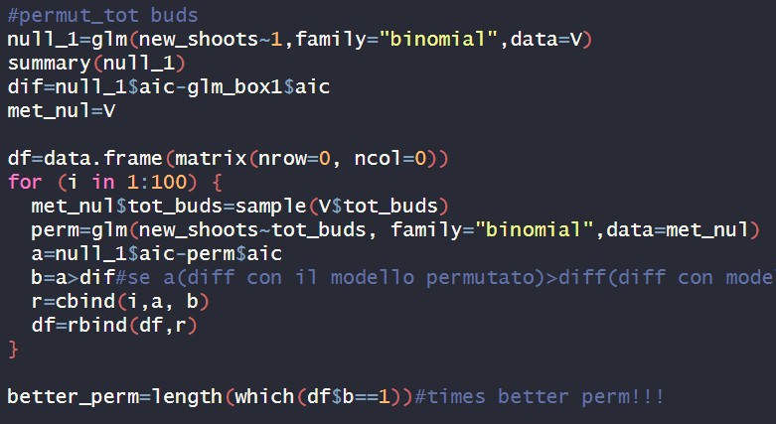
From V
Box4: do you burst?
Permutation_tot buds
3 times out of 100 the aic of null model- aic of permutated ones was greater than the difference with real model

Slide 39
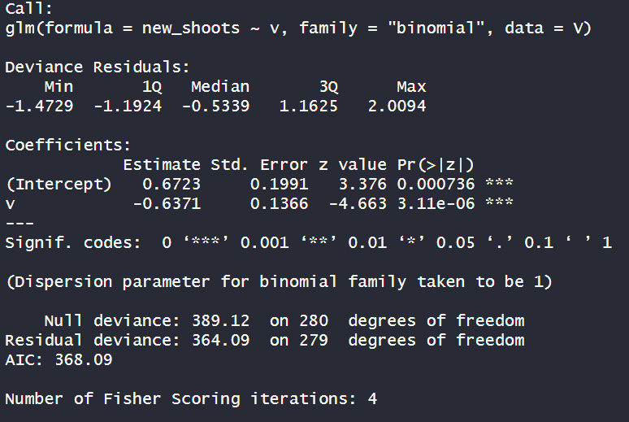
From V
Box4: do you burst?
5_Relation with other V in that sylleptic
New shoots (1=present, 0=absent), in V buds, other v in the same sylleptic
Conc:
V is significative(***). Coef: --0.63

Slide 40
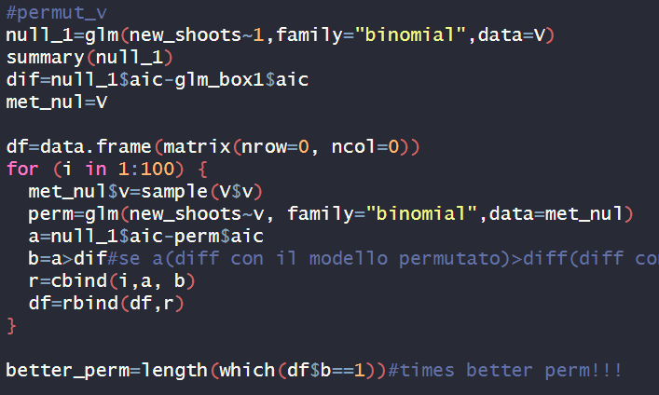
From V
Box4: do you burst?
Permutation_v
0 times out of 100 the aic of null model- aic of permutated ones was greater than the difference with real model

Slide 41
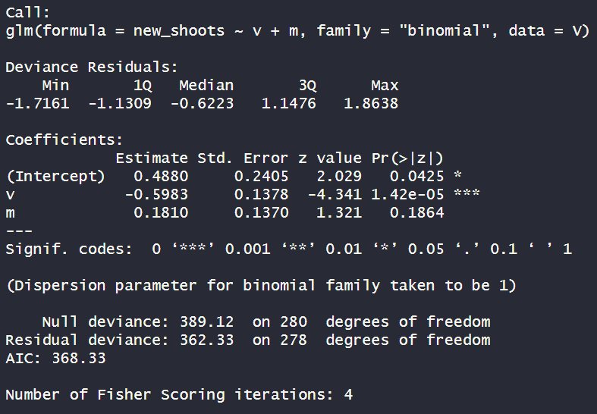
From V
Box4: do you burst?
5_Relation with M in that sylleptic
New shoots (1=present, 0=absent), in V buds,related to other v and m in the same sylleptic
Conc:
M IS NOT SIGNIFICANT

Slide 42
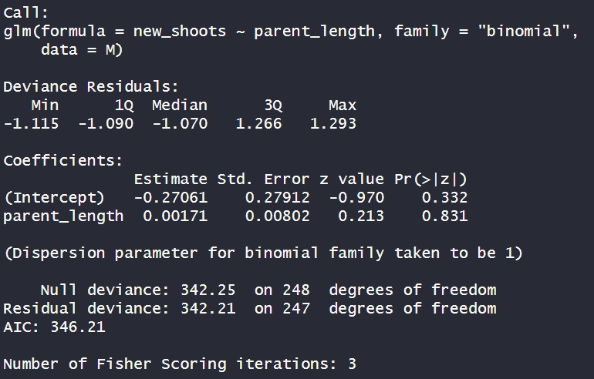
From M
Box4: do you burst?
1_Relation with LENGTH of parent shoot
New shoots (1=present, 0=absent), in M buds, related to length of parent shoot
Conc:
Length IS NOT SIGNIFICATIVE

Slide 43
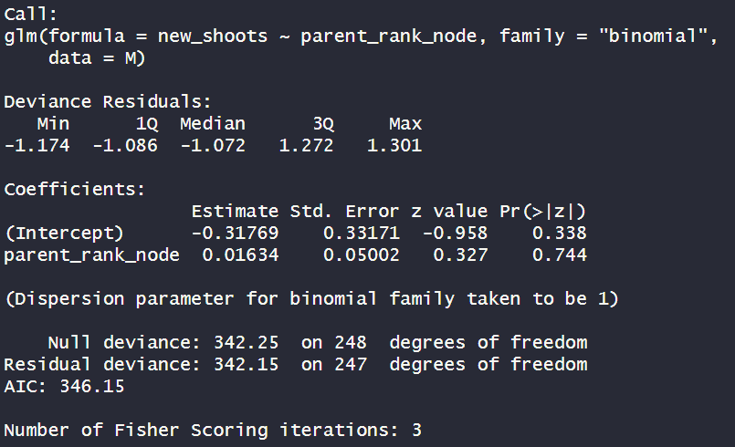
From M
Box4: do you burst?
2_Relation with RANK of parent shoot
New shoots (1=present, 0=absent), in M buds, related to rank node of that sylleptic
Conc:
RANK IS NOT SIGNIFICATIVE

Slide 44
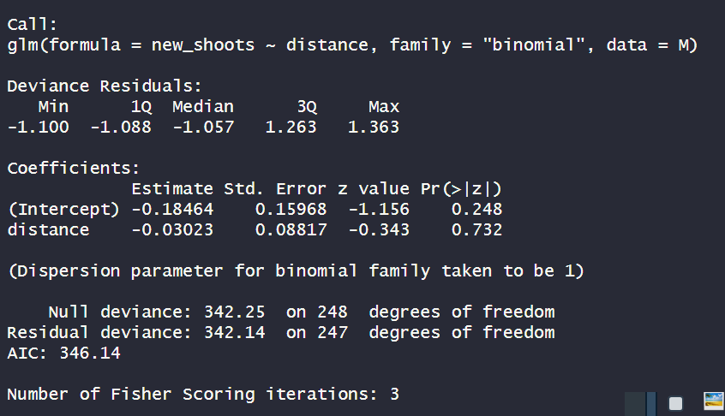
From M
Box4: do you burst?
3_Relation with distance
New shoots (1=present, 0=absent), from M buds, related to distance between parent ranks in sylleptic shoots
Conc:
distance IS NOT SIGNIFICATIVE

Slide 45
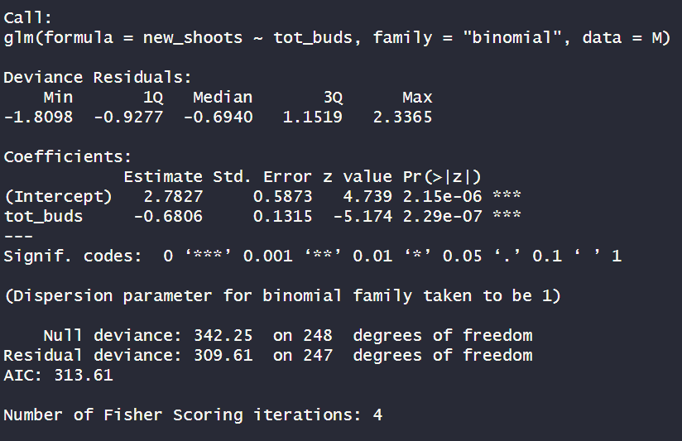
From M
Box4: do you burst?
4_Relation with TOT BUDS in that sylleptic
New shoots (1=present, 0=absent), in M buds, related to total buds of that sylleptic
Conc:
Tot buds is significative (*). Coef=-0.68

Slide 46

From M
Box4: do you burst?
Permutation_tot buds
0 times out of 100 the aic of null model- aic of permutated ones was greater than the difference with real model

Slide 47
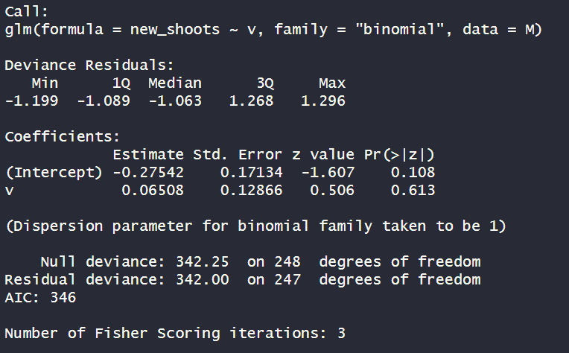
From M
Box4: do you burst?
5_Relation with other V in that sylleptic
New shoots (1=present, 0=absent), in M buds, other v and m in the same sylleptic
Conc:
V is not significative

Slide 48
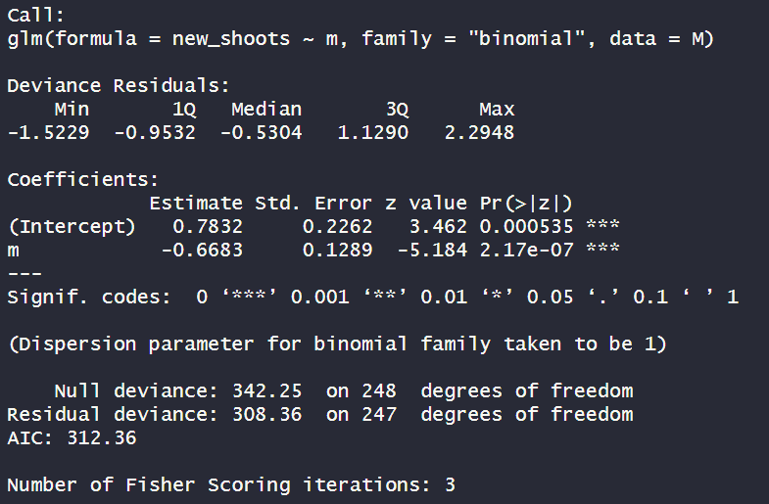
From M
Box4: do you burst?
6_Relation with M in that sylleptic
New shoots (1=present, 0=absent), in M buds, other m in the same sylleptic
Conc:
M is significant (***). Coef=-0.66

Slide 49
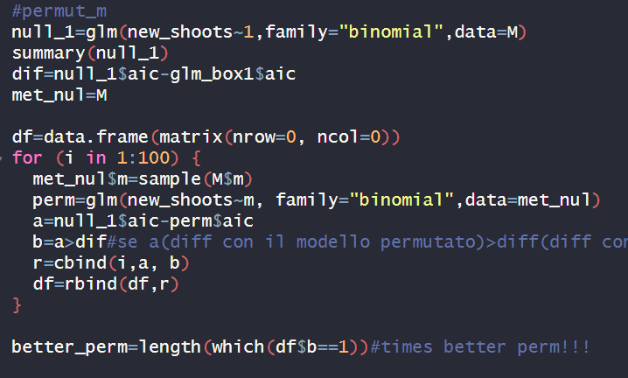
From M
Box4: do you burst?
Permutation_m
0 times out of 100 the aic of null model- aic of permutated ones was greater than the difference with real model

Slide 50
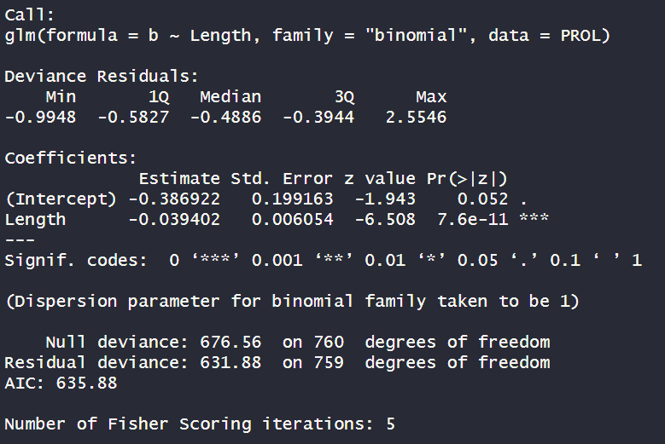
Box2.0: Existence of B (0,1)?
1_Relation with shoot LENGTH
Conc:
length is significant (***). Coef=-0.03

Slide 51
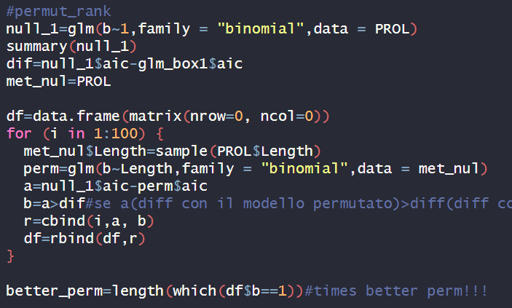
Box2.0: Existence of B (0,1)?
Permutation_length
0 times out of 100 the aic of null model- aic of permutated ones was greater than the difference with real model

Slide 52
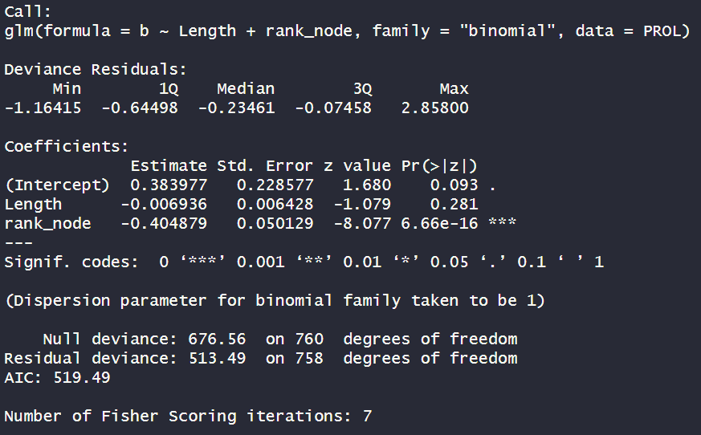
Box2.0: Existence of B (0,1)?
2_Relation with shoot LENGTH+RANK node
Conc:
RANK is significant (***). Coef=-0.4
Why length is not significant anymore? Because they are linked?
What should i do for permutation?

Slide 53


Box2: how many buds?
1_Relation with shoot LENGTH
Glm that relates number of buds IN proleptic shoot with length
Conc:
Length is significative(**). Coef=+0.06
This could confirm what we saw in exploratory: the majority is «1» bud

Slide 54

Box2: how many buds?
Permutation_length
0 times out of 100 the aic of null model- aic of permutated ones was greater than the difference with real model

Slide 55

Box2: how many buds?
2_Relation with RANK node
Glm that relates number of buds IN proleptic shoot with the shoot length and rank node
Conc:
Rank is significative(***). Coef=-0.04
This could confirm what we saw in exploratory: the majority is «1» bud
Why length is not significant anymore? Because they are linked?
What should i do for permutation?

Slide 56

Box3: proportion of V?
1_Relation with shoot LENGTH
Glm that relates proportion of V IN SYLLEPTIC shoot with rank node along the parent shoot
Use distance ?
Conc:
Length is not significative

Slide 57

Box3: proportion of V?
2_Relation with rank node
Glm that relate proportion ov V in IN proleptic shoot with rank node of parental
Conc:
Rank is significative (*). Coef=-0.03

Slide 58

Box3: proportion of V?
Permutation_rank
3 times out of 100 the aic of null model- aic of permutated ones was greater than the difference with real model

Slide 59

Box3: proportion of V?
3_Relation with distance
Glm that relate proportion ov V in IN proleptic shoot with distance
Conc:
distance is significative (***). Coef=0.19

Slide 60

Box3: proportion of V?
Permutation_distance
0 times out of 100 the aic of null model- aic of permutated ones was greater than the difference with real model

Slide 61

From V
Box4: do you burst?
1_Relation with LENGTH
New shoots (1=present, 0=absent), in V buds, related to length
Conc:
Length is significative(*). Coef: 0.01

Slide 62

Box4: do you burst?
Permutation_length
1 times out of 100 the aic of null model- aic of permutated ones was greater than the difference with real model

Slide 63

From V
Box4: do you burst?
2_Relation with Rank
New shoots (1=present, 0=absent), in V buds, related to length, rank node
Conc:
Rank is significative(*). Coef: 0.06
Why length is not significant anymore? Because they are linked?
What should i do for permutation?

Slide 64

From V
Box4: do you burst?
3_Relation with Tot_buds
New shoots (1=present, 0=absent), in V buds, related to length and total buds at that rank
Conc:
Length is significative(**). Coef: 0.02
Tot_buds is significative(**). Coef: -0.44

Slide 65
From V
Box4: do you burst?
3_Relation with Tot_buds
New shoots (1=present, 0=absent), in V buds, related to length and total buds at that rank
Conc:
Length is significative(**). Coef: 0.02
Tot_buds is significative(**). Coef: -0.44

Slide 66

From V
Box4: do you burst?
4_Relation with other V in that rank
Conc:
V is significative(***). Coef: -0.7

Slide 67

From V
Box4: do you burst?
Permutation_v
0 times out of 100 the aic of null model- aic of permutated ones was greater than the difference with real model

Slide 68

From V
Box4: do you burst?
4_Relation with other buds M in that rank
Conc:
M not significative

Slide 69

From M
Box4: do you burst?
1_Relation with shoot LENGTH
New shoots (1=present, 0=absent), in M buds, related to length
Conc:
Length is significative(**). Coef: 0.03

Slide 70

From M
Box4: do you burst?
Permutation_length
1 times out of 100 the aic of null model- aic of permutated ones was greater than the difference with real model

Slide 71

From M
Box4: do you burst?
2_Relation with Rank
New shoots (1=present, 0=absent), in M buds, related to length, rank node
Conc:
Rank is significative(*). Coef: 0.06
Why length is not significant anymore? Because they are linked?
What should i do for permutation?

Slide 72

From M
Box4: do you burst?
3_Relation with Tot_buds
New shoots (1=present, 0=absent), in M buds, related to length and total buds at that rank
Conc:
Length is significative(**). Coef: 0.03
Tot_buds is significative(***). Coef: -0.98

Slide 73

From M
Box4: do you burst?
Permutation_tot buds
0 times out of 100 the aic of null model- aic of permutated ones was greater than the difference with real model

Slide 74

From M
Box4: do you burst?
4_Relation with V in that rank
Conc:
V is significative(***). Coef: -1.57

Slide 75

From M
Box4: do you burst?
Permutation_v
0 times out of 100 the aic of null model- aic of permutated ones was greater than the difference with real model

Slide 76

From M
Box4: do you burst?
4_Relation with other buds V and M in that rank
Conc:
V is significative (***). Coef=-1.3
M is significative (***). Coef=-0.95

Slide 77

From M
Box4: do you burst?
Permutation_m
0 times out of 100 the aic of null model- aic of permutated ones was greater than the difference with real model

